Slide 1
OOPS + C#

Slide 2
Reference type variable

Slide 3
Concrete Class

Slide 4
Abstract Class

Slide 5
Abstract Class vs Interface

Slide 6
Extension Method

Slide 7
StringBuilder

Slide 8
Collection

Slide 9
Array vs ArrayList

Slide 10
Virtual Method

Slide 11
Event

Slide 12
Delegate

Slide 13
Abstract class vs interface

Slide 14
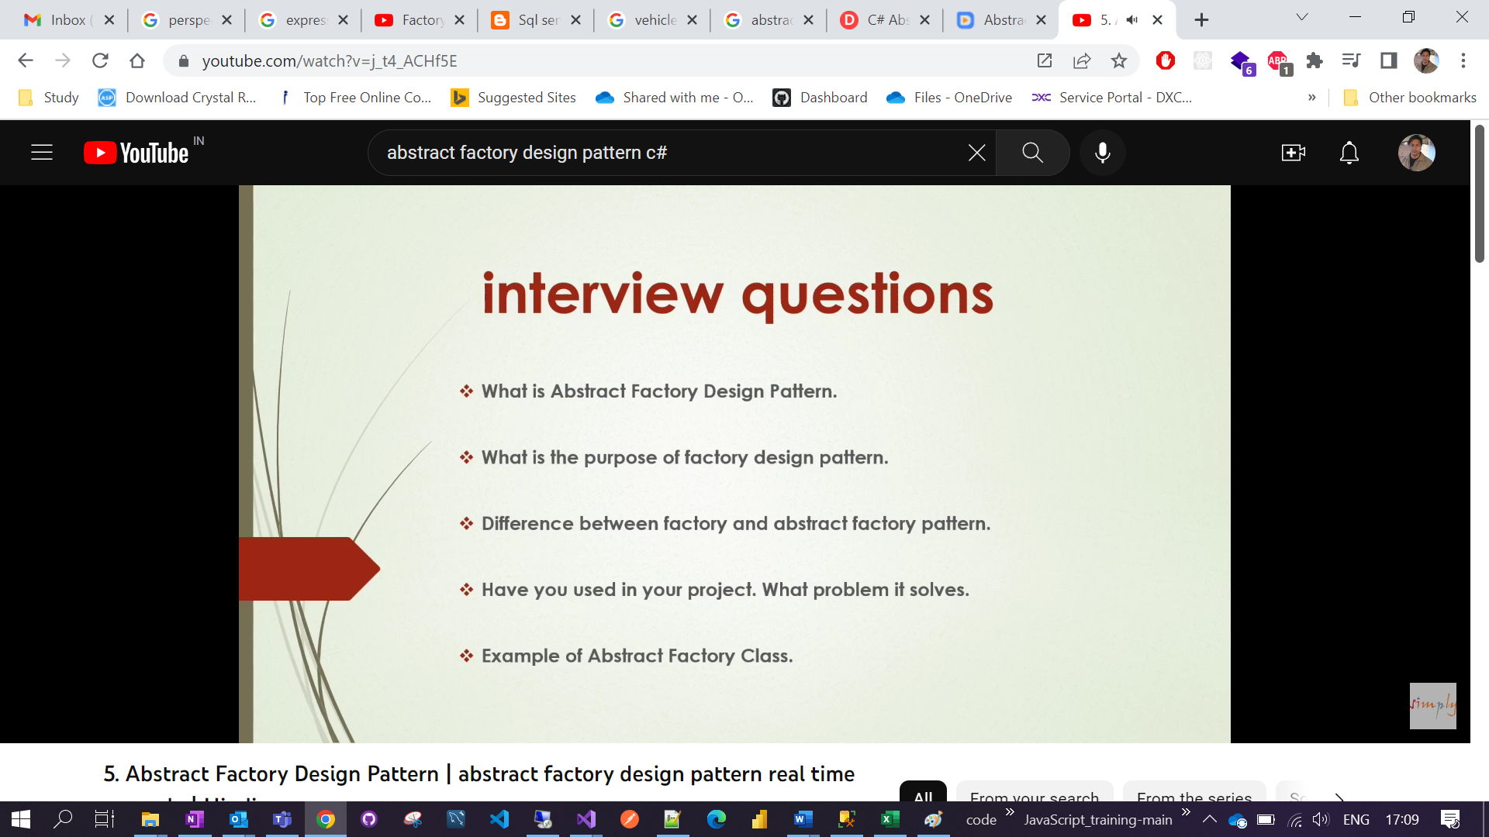

Slide 15
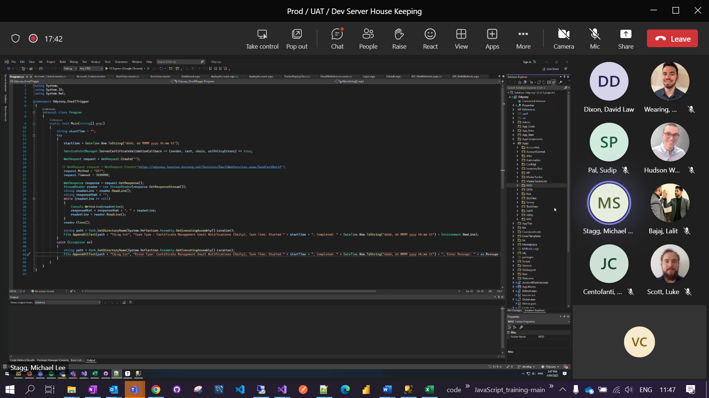

Slide 16
Design Principle vs Design Pattern

Slide 17
Liskov substitution principle
Liskov Substitution Principle (LSP) states that objects of a superclass should be replaceable with objects of its subclasses without breaking the application. In other words, what we want is to have the objects of our subclasses behaving the same way as the objects of our superclass.

Slide 18
Communication between two thread or how to pass information from one thread to another thread.

Slide 19
Thread

